Slide 1
Automated Essay Scoring 2.0
Javier Trujillo Castro

Slide 2

Project Objective
The goal of this project is to develop and evaluate machine learning models capable of automatically grading essays. Automated essay scoring systems can significantly reduce the workload of educators and provide consistent and objective assessments of student writing.

Slide 3
Data Used
Description of the Dataset:
Number of essays: 10,000
Source: The dataset is sourced from the Automated Student Assessment Prize (ASAP) competition on Kaggle.
Essay Length: Essays vary in length, with some as short as 150 words and others as long as 700 words.
Scoring: Essays are scored on a scale of 1 to 6 by human raters based on factors such as content, organization, and language use.

Slide 4
Data Preprocessing

Slide 5
Data Preprocessing
Preprocessing the data cleans and standardizes the text, reducing noise and inconsistencies. This improves the quality of the input data, ensuring that the machine learning models can learn more effectively. Key preprocessing steps, such as lemmatization, stop word removal, and text normalization, enhance the model's ability to understand the underlying patterns and semantics in the data, leading to better performance and generalization.
Lemmatization and Stop Words Removal
Text Cleaning
Data Augmentation with Synonym Replacement
Dataset Balancing
Use of Word Embeddings
Tokenization and Padding

Slide 6
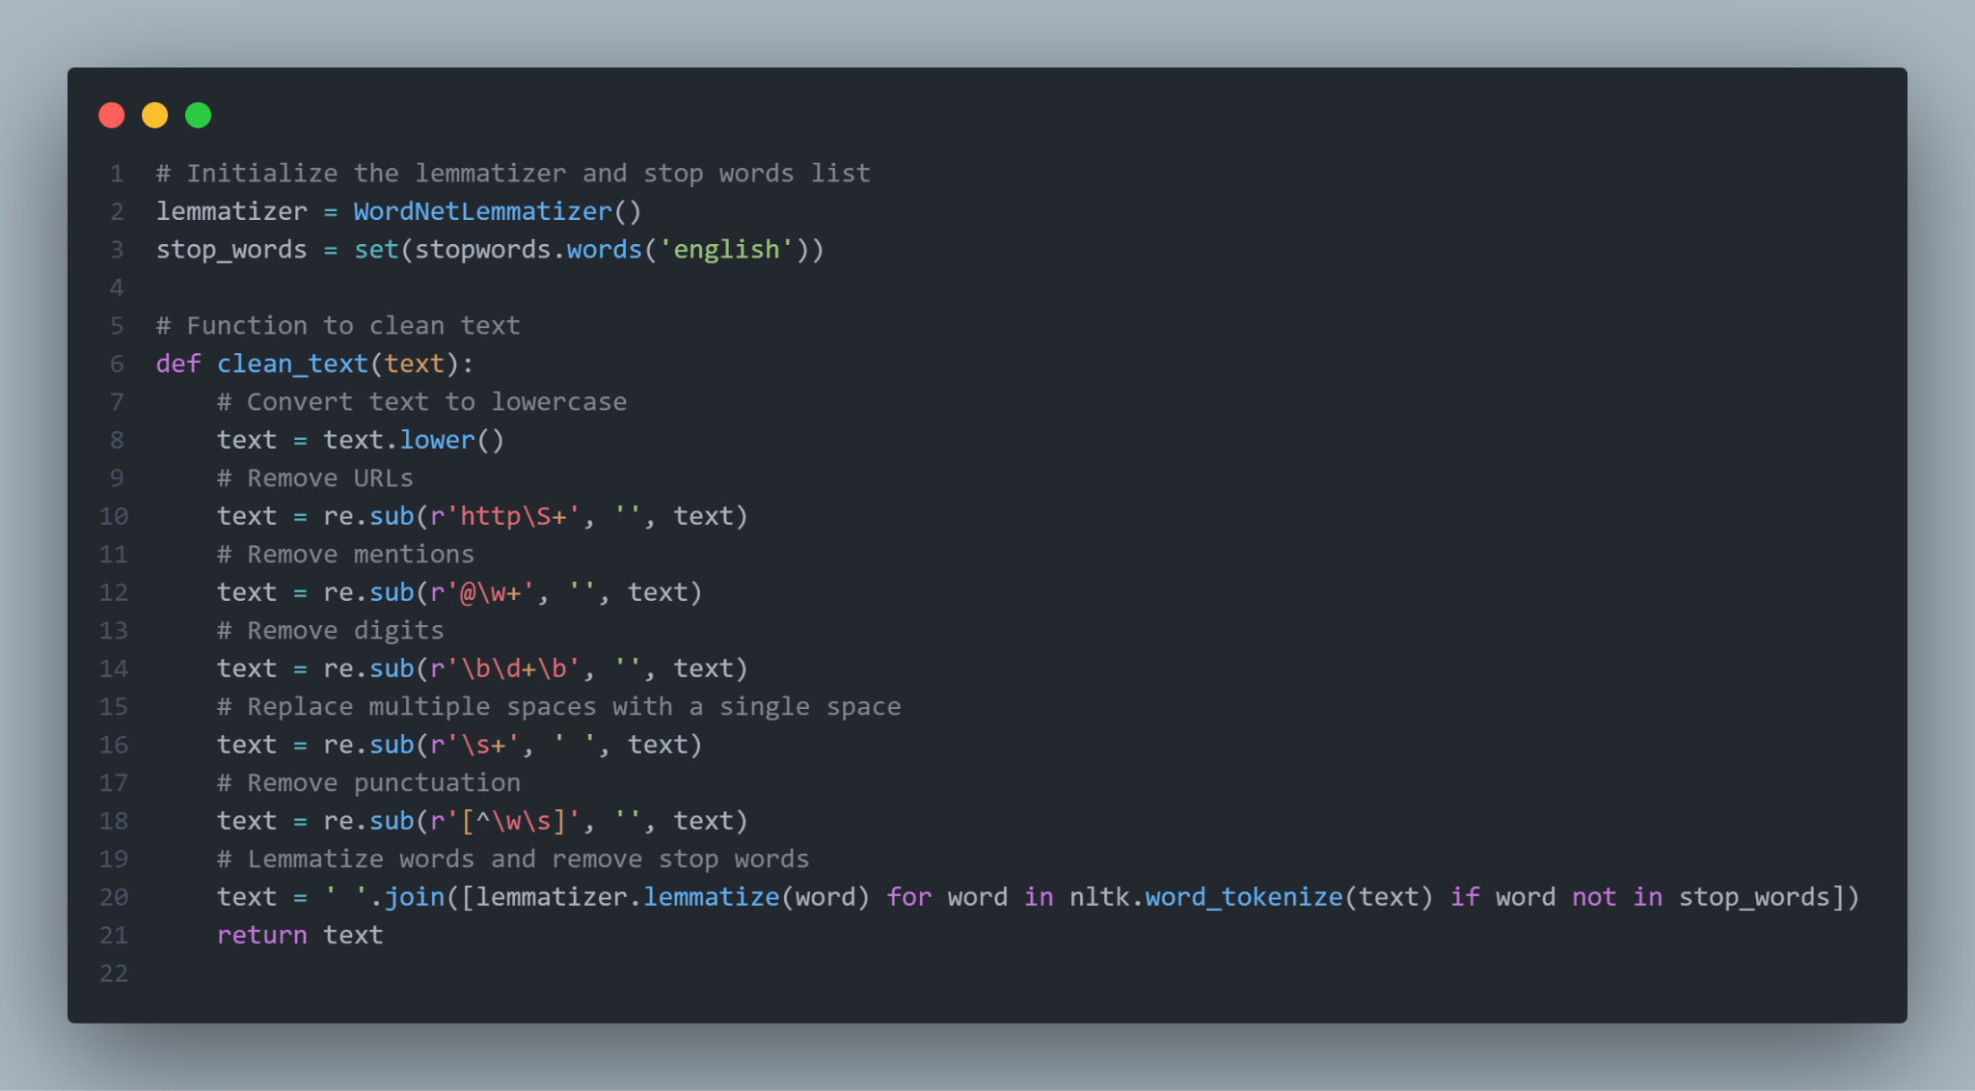
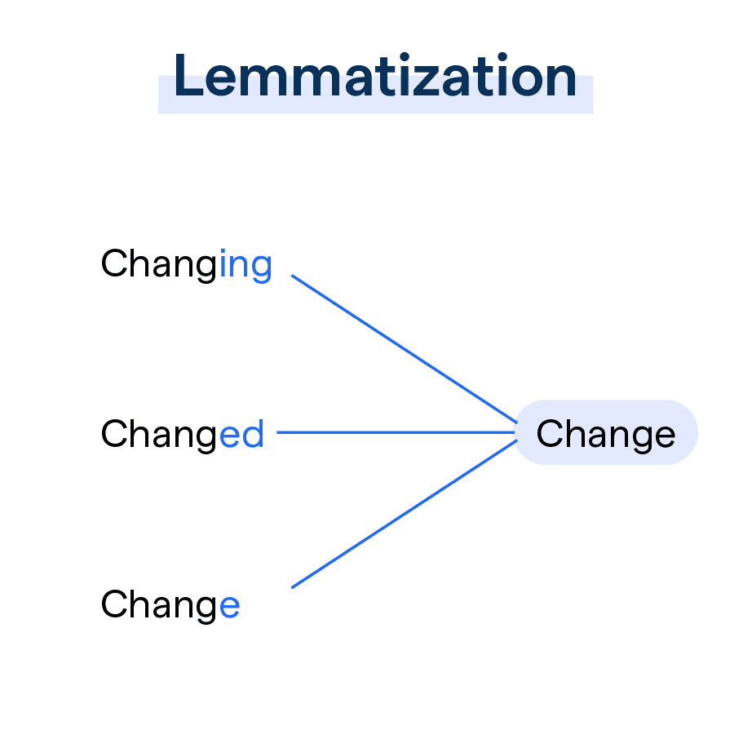
Lemmatization & Stop Words Removal
Lemmatization: Lemmatization reduces words to their base form (lemma), which helps normalize the text. For example, "running" becomes "run." This reduces text dimensionality and improves word representation consistency.
Stop Words Removal: Stop words are common words that do not add significant meaning by themselves (such as "the," "and," "is"). Removing them reduces noise and improves the performance of NLP models by focusing on the words that provide more information.

Slide 7
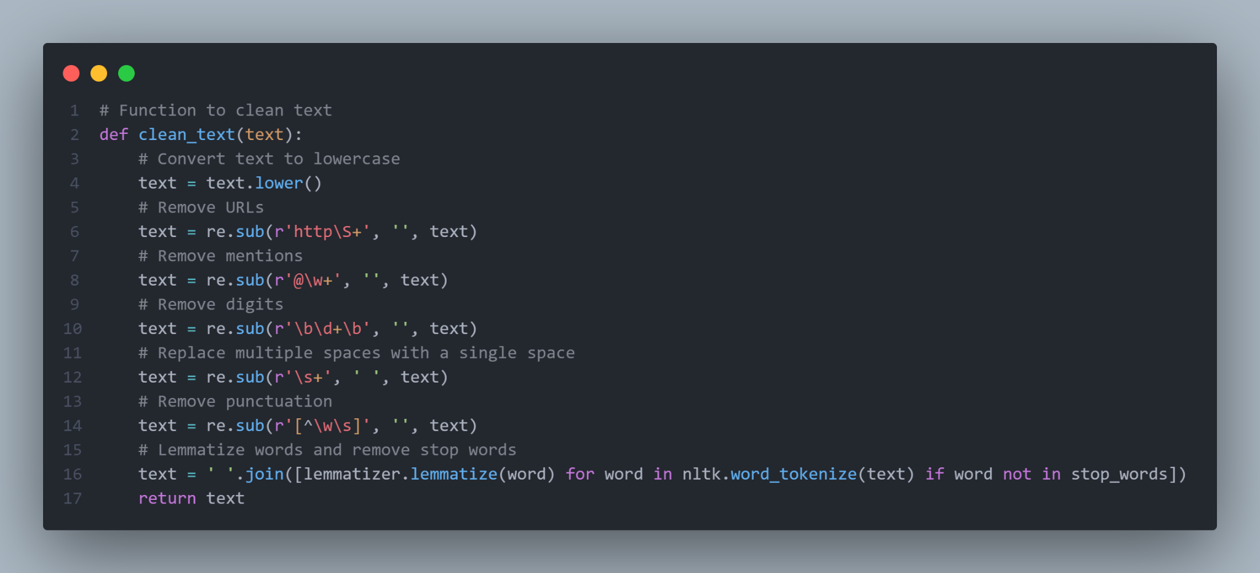

Text Cleaning
Removal of URLs, Mentions, and Digits: This eliminates unnecessary noise that could negatively affect data quality.
Lowercase Conversion: This helps treat words uniformly without distinguishing between uppercase and lowercase, which reduces dimensionality and improves text coherence.
Punctuation Removal: Punctuation is not always useful in NLP models, especially in bag-of-words or word embeddings models, and can be removed to simplify the text.

Slide 8

Data Augmentation with Synonym Replacement
Synonym Replacement: This data augmentation technique generates variations of the original text by replacing some words with their synonyms. This can help train more robust and generalizable models by increasing dataset diversity without changing its meaning.

Slide 9
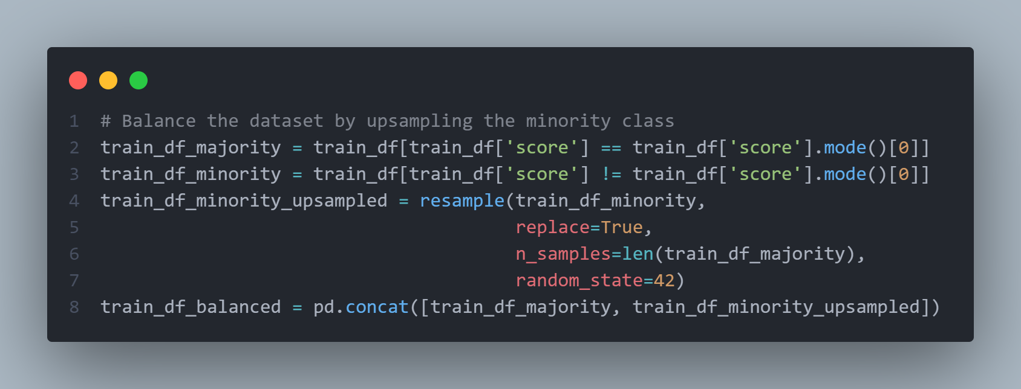
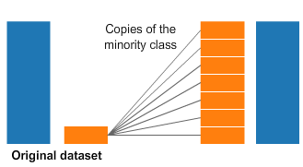
Dataset Balancing
Minority Class Upsampling: Balancing the dataset by increasing samples of the minority class helps prevent model bias towards the majority class. This is crucial in imbalanced classification problems to ensure the model learns to recognize and adequately handle all classes.

Slide 10

Use of Word Embeddings
FastText: Training a FastText model captures semantic representations of words, including morphological and contextual information. FastText is especially useful for languages with many derived forms and for capturing similarities between words. FastText has been used instead of Word2Vec because it can generate embeddings for out-of-vocabulary words by using subword information (n-grams), making it more robust for handling rare words or new terms that were not present in the training data. This characteristic is particularly beneficial for applications involving diverse and dynamic vocabularies.
GloVe: Using pre-trained embeddings like GloVe leverages semantic knowledge learned from large text corpora, improving the model's ability to understand word meanings and relationships.

Slide 11
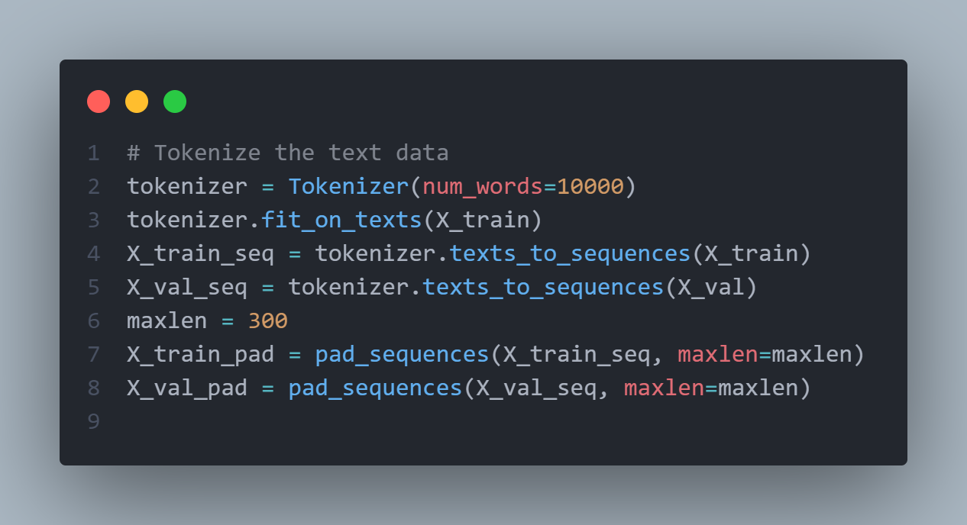
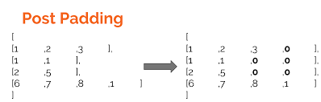
Tokenization & Padding
Tokenization: Converting text into sequences of integers representing words allows machine learning models to process the text effectively.
Padding: Ensuring all sequences have the same length is necessary for batch processing and training neural networks, as these require uniform input lengths.

Slide 12
Training Process

Slide 13
Training Process
Training models in machine learning is a crucial process where preprocessed data is used to build and optimize neural network architectures such as LSTM, GRU, CNN, and hybrid models. Each model incorporates an embedding layer initialized with GloVe embeddings, facilitating semantic understanding. The models are trained using custom loss functions and the Adam optimizer over multiple epochs, validating their performance on unseen data to ensure generalization. Trained models are saved for future deployment and evaluation, enabling comprehensive comparison to determine the most effective model for essay scoring applications.
Loading and Preparing Data
Embedding Preparation
Model Architectures
Training and Evaluation

Slide 14
Loading & Preparing Data
Embedding Preparation
Data preparation is critical to ensure that the neural network models receive structured and meaningful input. In this context, the preprocessed data includes tokenized sequences of essays (X_train_pad, X_val_pad) and their corresponding scores (y_train, y_val). The tokenizer, which converts textual data into numerical sequences, is loaded to maintain consistency between training and validation datasets. This step ensures that the models can effectively interpret and learn from the essay content.
Embeddings play a crucial role in representing words numerically in a way that captures semantic relationships. The code uses pre-trained GloVe embeddings (Global Vectors for Word Representation), which are vectors that encode semantic meaning based on word co-occurrence statistics in large text corpora. By preparing an embedding matrix (embedding_matrix) that maps each word index from the tokenizer to its corresponding GloVe embedding vector, the models can leverage this semantic knowledge during training. This choice is motivated by GloVe’s ability to encode rich semantic information, enhancing the models’ understanding of the essays.

Slide 15
Model Architectures
The choice of neural network architectures LSTM, GRU, CNN, and a hybrid model reflects considerations of how best to process and learn from the sequential nature of textual data:
LSTM (Long Short-Term Memory) and GRU (Gated Recurrent Unit) models are selected for their ability to capture long-range dependencies in sequential data, such as essays. These models incorporate memory cells that can store information over extended periods, enabling them to understand and predict sequences with context.
CNN (Convolutional Neural Network) models are chosen for their strength in capturing local patterns through convolutional filters, which are adept at identifying features in the essays that are relevant to scoring.
The hybrid model combines elements from LSTM, GRU, and CNN architectures. This approach aims to leverage the strengths of each model type—long-range dependencies in LSTM/GRU and local feature extraction in CNN—simultaneously. By integrating these diverse perspectives, the hybrid model seeks to improve overall performance by capturing a broader range of textual features.

Slide 16
Training
Compilation: Before training begins, each model is compiled with a custom loss function tailored to the specific task of essay scoring. The choice of loss function, optimizer Adam, and evaluation metric Mean Absolute Error (MAE) is guided by the goal of minimizing prediction error and improving model accuracy.
Training: Models are trained iteratively on the training data across multiple epochs. During training, the models adjust their internal parameters based on the loss calculated between predicted and actual scores. This process allows the models to learn meaningful representations from the essays and optimize their ability to predict scores.
Validation: Validation data is used periodically during training to assess how well the models generalize to unseen essay samples. Monitoring performance on the validation set helps prevent overfitting. By validating against unseen data, the models’ ability to generalize is tested, ensuring robust performance in real-world applications.

Slide 17
Evaluating Process

Slide 18
Evaluating the Model Performance
Evaluating models is essential to determine their performance in the task of essay scoring. We use several metrics to understand the results. The Mean Absolute Error (MAE) measures the average of absolute errors, providing a clear idea of the model's accuracy. The Mean Squared Error (MSE), which averages squared errors, highlights large errors more than MAE. The R2 Score indicates the proportion of variance explained by the model, while precision, recall, and F1 Score evaluate the model's performance in terms of correct classification. Together, these metrics offer a comprehensive view of the model's performance and help identify the most effective model.
Additionally, qualitative analysis of the texts, including the best and worst cases, provides deeper insights. By examining essays with the smallest and largest prediction errors, we can understand the strengths and weaknesses of each model. This involves analyzing the number of sentences, words, unique words, and errors in the text, as well as the true and predicted scores. Such qualitative assessments complement quantitative metrics, offering a holistic evaluation of model performance and guiding further improvements.

Slide 19
First Approach

Slide 20
LSTM Model

Slide 21
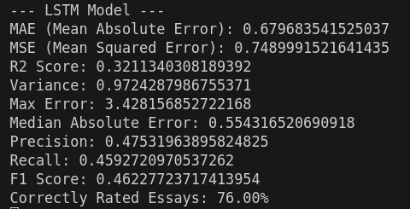
Evaluating the LSTM Model

Slide 22
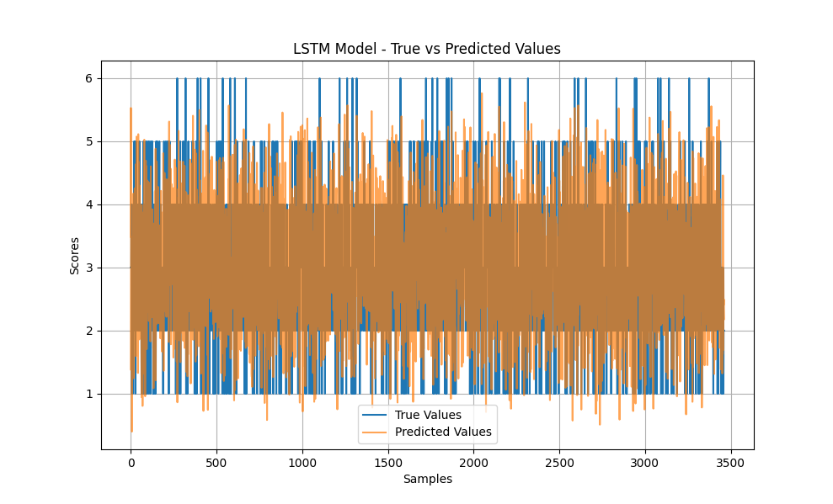
Evaluating the LSTM Model

Slide 23
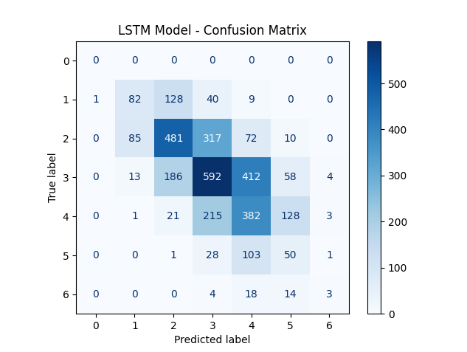
Evaluating the LSTM Model

Slide 24
GRU Model

Slide 25
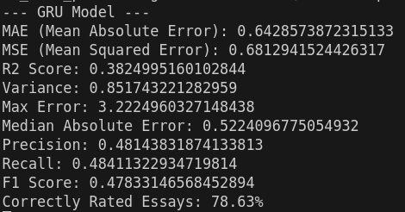
Evaluating the GRU Model

Slide 26
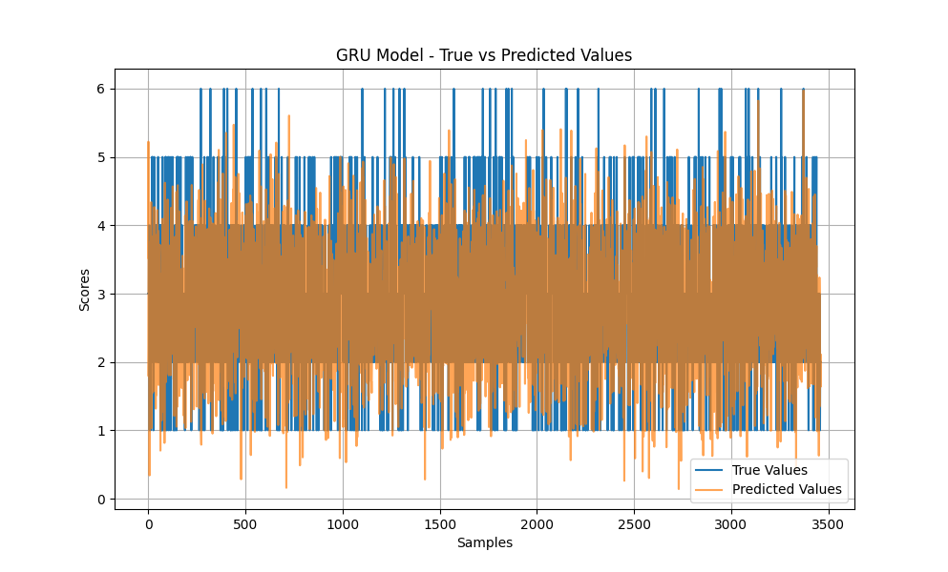
Evaluating the GRU Model

Slide 27
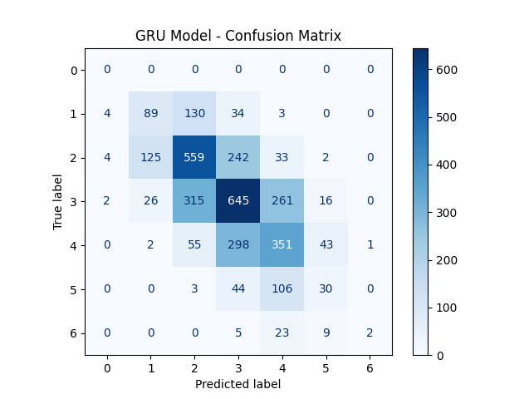
Evaluating the GRU Model

Slide 28
CNN Model

Slide 29
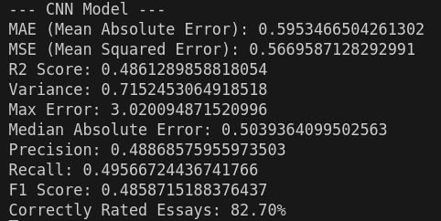
Evaluating the CNN Model

Slide 30
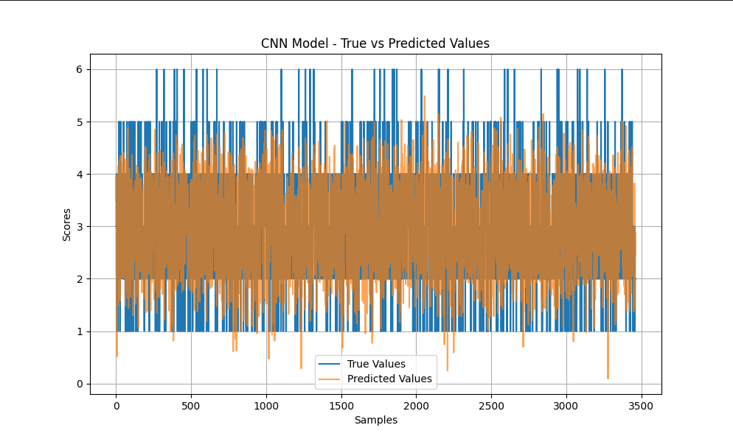
Evaluating the CNN Model

Slide 31
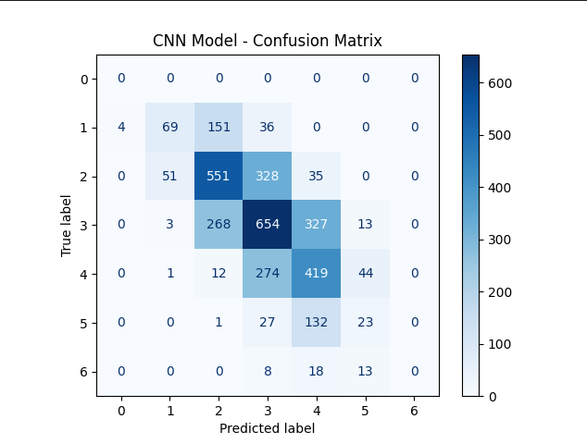
Evaluating the CNN Model

Slide 32
Comparison between models

Slide 33
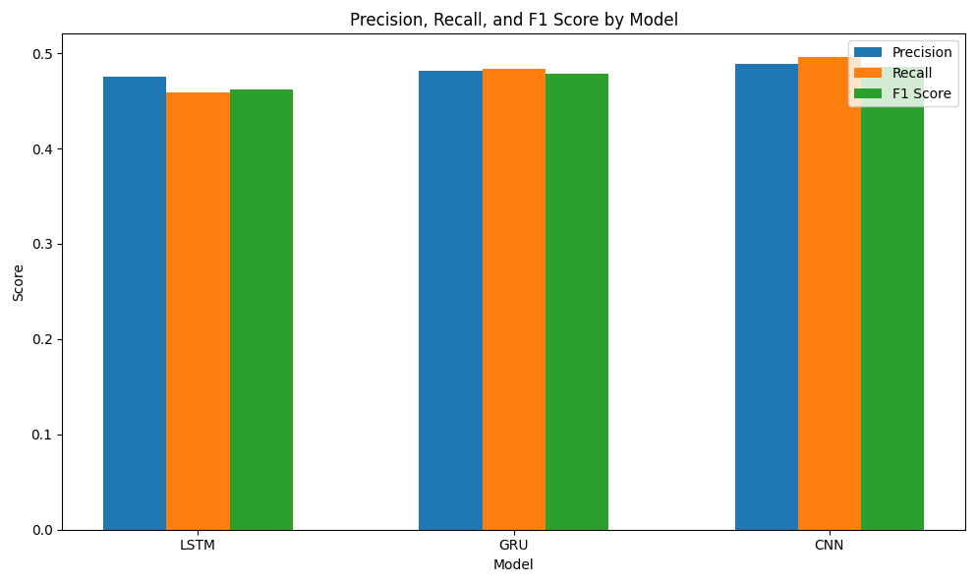
Comparison between the models

Slide 34
Comparison between the models
Precision: Measures how many predicted grades are correct. Higher precision means fewer false positives.
Recall: Measures how many actual grades are correctly identified. Higher recall means fewer false negatives.
F1 Score: The harmonic mean of precision and recall, balancing both metrics. Higher F1 score indicates better overall performance.
Best-Performing Model
CNN Model: Best in precision (0.4887), recall (0.4957), and F1 score (0.4859). Most reliable and effective overall.
GRU Model: Moderate precision (0.4814), recall (0.4841), and F1 score (0.4783). Decent but not as good as CNN.
LSTM Model: Lowest precision (0.4753), recall (0.4593), and F1 score (0.4623). Least reliable and effective.
The CNN model is the best-performing as it makes accurate and reliable predictions with a good balance between precision and recall.

Slide 35
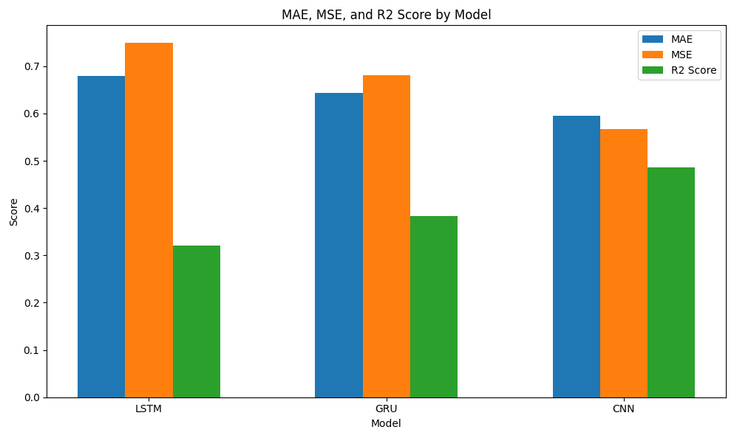
Comparison between the models

Slide 36
Comparison between the models
Mean Absolute Error (MAE): Measures the average magnitude of errors between predicted and actual values.
Mean Squared Error (MSE): Measures the average squared difference between predicted and actual values.
R2 Score: Indicates the proportion of variance in the dependent variable predictable from the independent variables.
Best-Performing Model
MAE: CNN model performs the best with the lowest error (0.5953), followed by GRU (0.6429) and LSTM (0.6797).
MSE: CNN model has the lowest error (0.5670), followed by GRU (0.6813) and LSTM (0.7490).
R² Score: CNN model has the highest score (0.4861), indicating it explains the most variance, followed by GRU (0.3825) and LSTM (0.3211).
The CNN model outperforms both the GRU and LSTM models in MAE, MSE, and R² Score, indicating it is the best model for this task based on these metrics

Slide 37
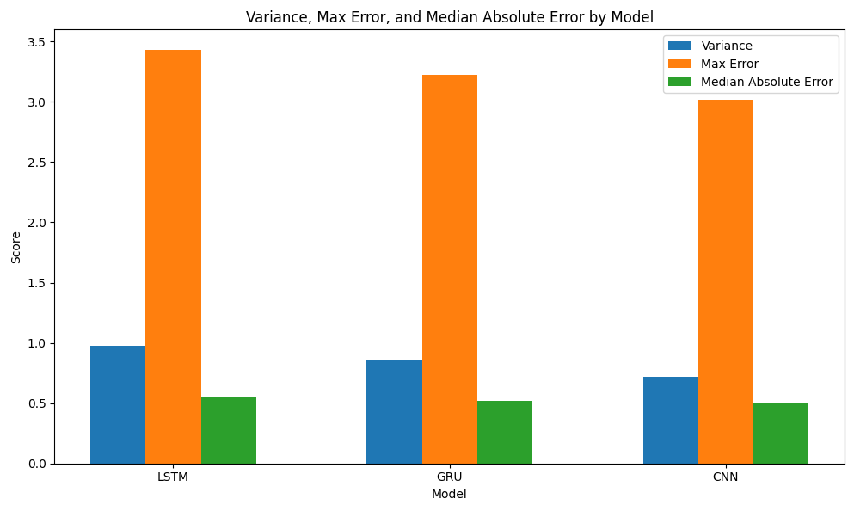
Comparison between the models

Slide 38
Comparison between the models
Variance: Indicates the dispersion of the predicted values.
Max Error: The largest absolute error between predicted and actual values.
Median Absolute Error: The median of the absolute errors.
Results
Variance: LSTM model has the highest variance (0.9724), indicating the widest spread.
Max Error: CNN model has the lowest max error (3.0201), followed by GRU (3.2225) and LSTM (3.4282).
Median Absolute Error: CNN model performs the best with the lowest median absolute error (0.5039), followed by GRU (0.5224) and LSTM (0.5543).
CNN model has the lowest max error and median absolute error, making it the best in these metrics.

Slide 39
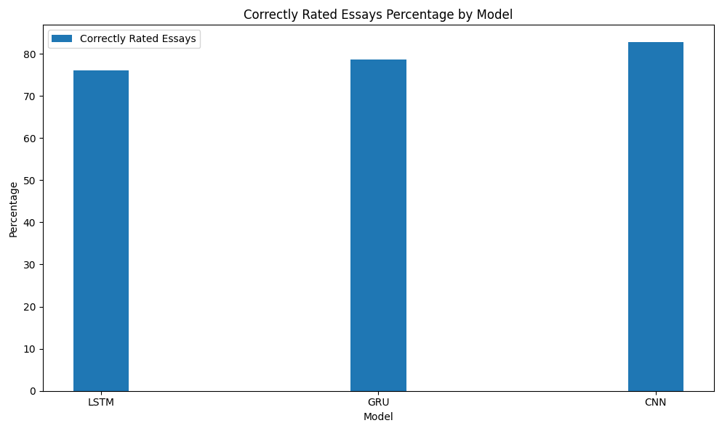
Comparison between the models

Slide 40
Comparison between the models
CNN Model performs the best, correctly rating 82.70% of essays.
GRU Model is the second best with 78.63%.
LSTM Model has the lowest percentage, correctly rating 76.00% of essays.
Best-Performing Model
The CNN model has the highest percentage of correctly rated essays, indicating it is the most accurate in terms of classification among the three models.

Slide 41
Improved models:
FastText & GloVe + Hybrid Model

Slide 42
LSTM Model

Slide 43
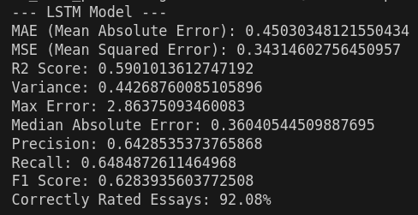
Evaluating the LSTM Model

Slide 44
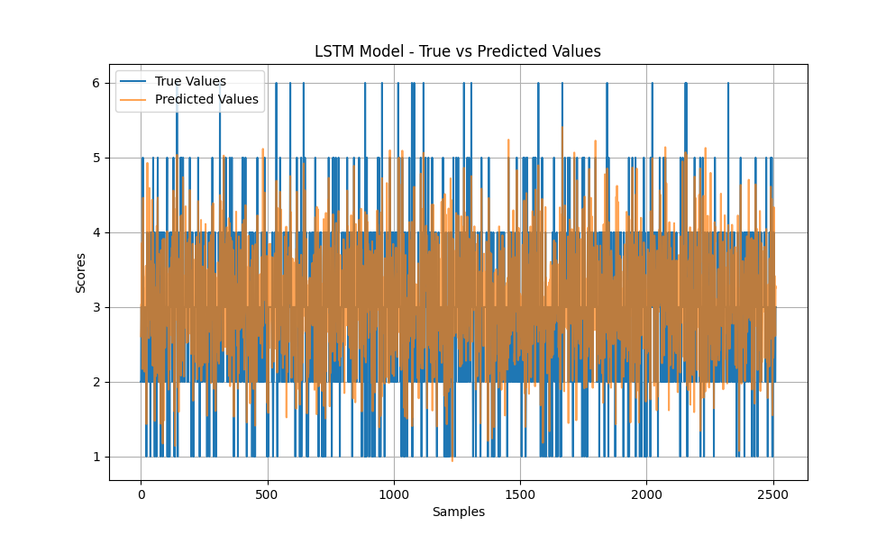
Evaluating the LSTM Model

Slide 45
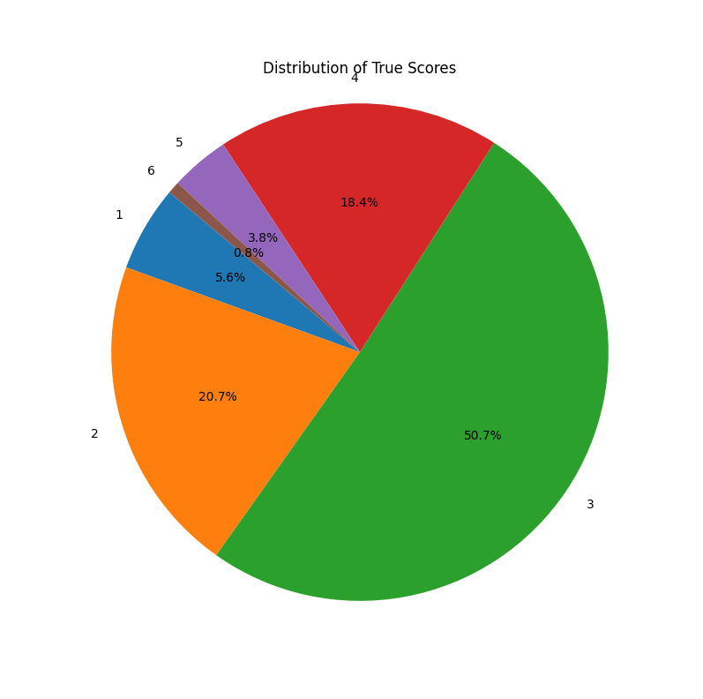
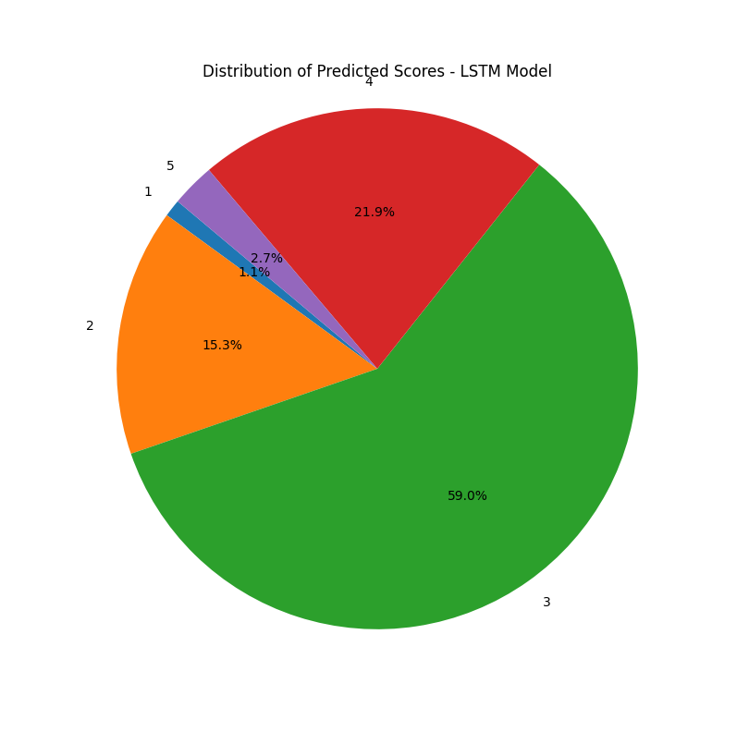
Evaluating the LSTM Model

Slide 46
Best Predictions

Slide 47
Evaluating the LSTM Model
Model: LSTM Model, Type: Best
True Score: 2 Predicted Score: 2.000246286392212 Number of Sentences: 2 Number of Words: 102 Unique Words: 65
Essay Text:
I think a computer being able to scan a kid's face and tell if he or she is mad doesn't mean the CIA or FBI knows everyone's face. If a computer knows, someone could hack the camera and see everything, which is an invasion of privacy. I think that's why many stalkers and weird people know how to hack into people's computers and smartphones to track and spy on them at home without their knowledge. I don't think a computer being able to scan a teacher's or student's face would be useful. People would cover the camera to prevent anyone from hacking and seeing them. I think we should stop trying to make stuff that scans faces because it's an invasion of privacy.

Slide 48
Evaluating the LSTM Model
Model: LSTM Model, Type: Best
True Score: 3 Predicted Score: 2.999643325805664 Number of Sentences: 1 Number of Words: 115 Unique Words: 65
Essay Text:
Yes, the face on Mars. Some people say the face was created by aliens, but that statement isn't true. The face was not created by aliens; it is a natural landform. This landform is actually a lava dome that got shaped in a funny way when the lava hardened. It will remain like that unless something really bad happens. Some claim aliens built the face using the best cameras, but there is no evidence of that. It seems more like something that occurred naturally, much like the Grand Canyon on Earth. Humans or aliens did not build the Grand Canyon; it is a natural formation, just like the face on Mars. Pictures taken by NASA, even when zoomed in, would have picked up anything unusual if it was there.

Slide 49
Worst Predictions

Slide 50
Evaluating the LSTM Model
Model: LSTM Model, Type: Worst
True Score: 1 Predicted Score: 3.7257351875305176 Error: 2.7257351875305176 Number of Sentences: 5 Number of Words: 319 Unique Words: 221
Essay Text:
Something big is beginning. Cars are starting to become questionable in terms of necessity. Of course, there is a need for cars, but the situation with car sales is declining. If people become united in one way and work together, we could accomplish many things. Besides, cars emit gases that get trapped in the atmosphere, and we need to conserve the ozone layer. Without it, skin cancer would surely increase due to hard-hitting UV rays. I believe cars are becoming outdated. Do we really need them? Many of them are giving off harmful gases that are destroying our home. Smog must be clouding our perception, and we aren't thinking straight. We are destroying the planet for money. To get to the truth of this essay...

Slide 51
Evaluating the LSTM Model
Model: LSTM Model, Type: Worst
True Score: 1 Predicted Score: 3.86375093460083 Error: 2.86375093460083 Number of Sentences: 1 Number of Words: 245 Unique Words: 178
Essay Text:
Driverless cars could be helpful and seem safe. They are already used by Google and could help people with disabilities that make them unable to drive go where they need to go. First, using sensors to help navigate, developing special roads, smart roads, and test tracks built by General Motors, they built concept cars that could run on special tracks embedded with electrical cables that sent radio signals to a receiver at the front end of the car. Engineers at Berkeley tried something similar using magnets with alternating polarity that the car could read using binary code. However, this proved expensive, so they started putting sensors in the car for position estimation...

Slide 52
GRU Model

Slide 53
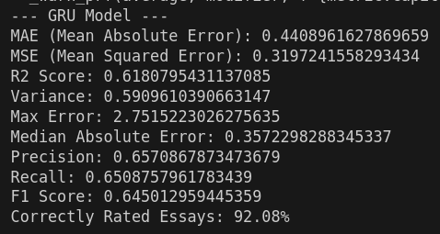
Evaluating the GRU Model

Slide 54
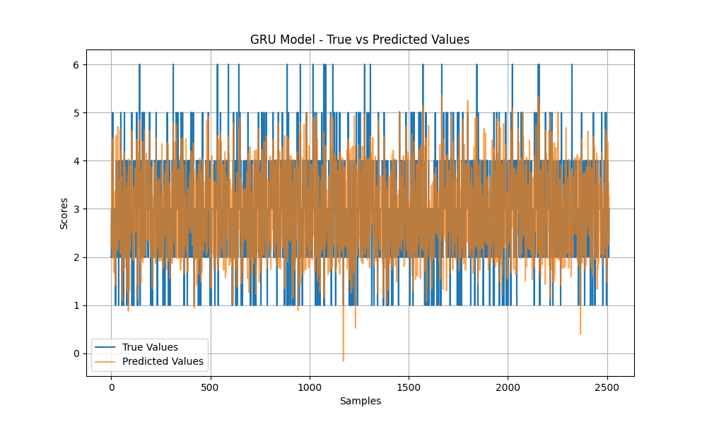
Evaluating the GRU Model

Slide 55
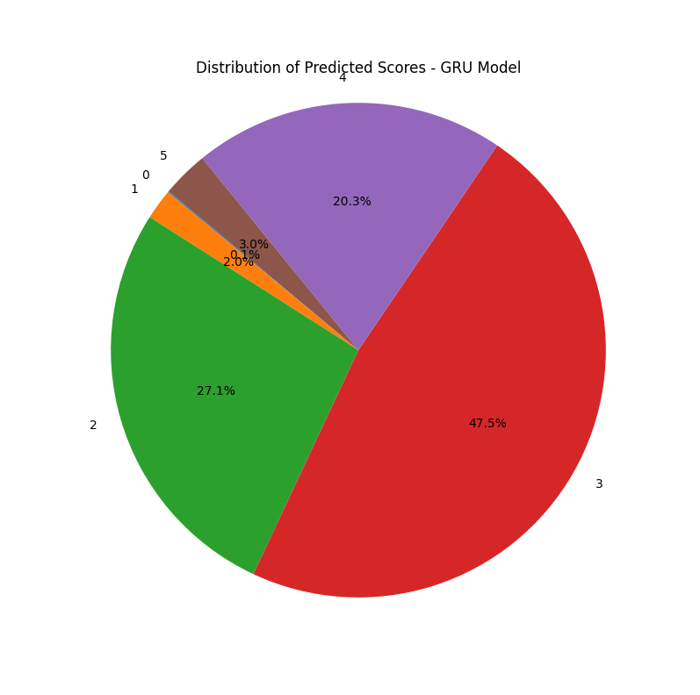
Evaluating the GRU Model

Slide 56
Best Predictions

Slide 57
Evaluating the GRU Model
Model: GRU Model, Type: Best
True Score: 3 Predicted Score: 3.000267744064331 Error: 0.0002677440643310547 Number of Sentences: 1 Number of Words: 189 Unique Words: 106
Essay Text:
I don't think it would be worth the money to put technology in classrooms to see how students are feeling. Not everyone wants everyone else to know their feelings. If I'm mad, I don't want everyone knowing what's going on. I'd rather not talk to anyone unless I ask for help in a situation. Putting technology in classrooms to tell how every child is feeling means everyone would know each other's business. As the article stated, it could help a teacher know if a child is bored or confused, but the child might not want the student called out. Probably, a student struggling in class doesn't want everyone to know they are struggling or confused. They need to ask the teacher privately if they need help.

Slide 58
Evaluating the GRU Model
Model: GRU Model, Type: Best
True Score: 3 Predicted Score: 3.00058913230896 Error: 0.0005891323089599609 Number of Sentences: 1 Number of Words: 150 Unique Words: 110
Essay Text:
The article "Unmasking the Face on Mars" presents different theories, but I think the logical answer is that the face is a natural landform. The article states logical reasons against the conspiracy theory. NASA has done research, and the article provides pictures from various dates to show that it's really a mesa, a natural formation. Twenty-five years ago, Viking spotted a likeness to a human face with an enormous head nearly two miles end to end. It unveiled a huge rock formation that resembles a human head, but some refused to believe it, insisting that NASA was hiding the truth.

Slide 59
Worst Predictions

Slide 60
Evaluating the GRU Model
Model: GRU Model, Type: Worst
True Score: 1 Predicted Score: 3.654546022415161 Error: 2.654546022415161 Number of Sentences: 5 Number of Words: 319 Unique Words: 221
Essay Text:
Something big is beginning. Cars are starting to become questionable in terms of necessity. Of course, there is a need for cars, but the situation with car sales is declining. If people become united in one way and work together, we could accomplish many things. Besides, cars emit gases that get trapped in the atmosphere, and we need to conserve the ozone layer. Without it, skin cancer would surely increase due to hard-hitting UV rays. I believe cars are becoming outdated. Do we really need them? Many of them are giving off harmful gases that are destroying our home. Smog must be clouding our perception, and we aren't thinking straight. We are destroying the planet for money. To get to the truth of this essay...

Slide 61
Evaluating the GRU Model
Model: GRU Model, Type: Worst
True Score: 1 Predicted Score: 3.7515223026275635 Error: 2.7515223026275635 Number of Sentences: 1 Number of Words: 245 Unique Words: 178
Essay Text:
Driverless cars could be helpful and seem safe. They are already used by Google and could help people with disabilities that make them unable to drive go where they need to go. First, using sensors to help navigate, developing special roads, smart roads, and test tracks built by General Motors, they built concept cars that could run on special tracks embedded with electrical cables that sent radio signals to a receiver at the front end of the car. Engineers at Berkeley tried something similar using magnets with alternating polarity that the car could read using binary code. However, this proved expensive, so they started putting sensors in the car for position estimation...

Slide 62
CNN Model

Slide 63
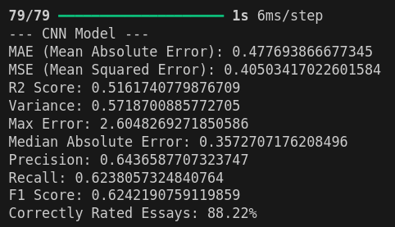
Evaluating the CNN Model

Slide 64
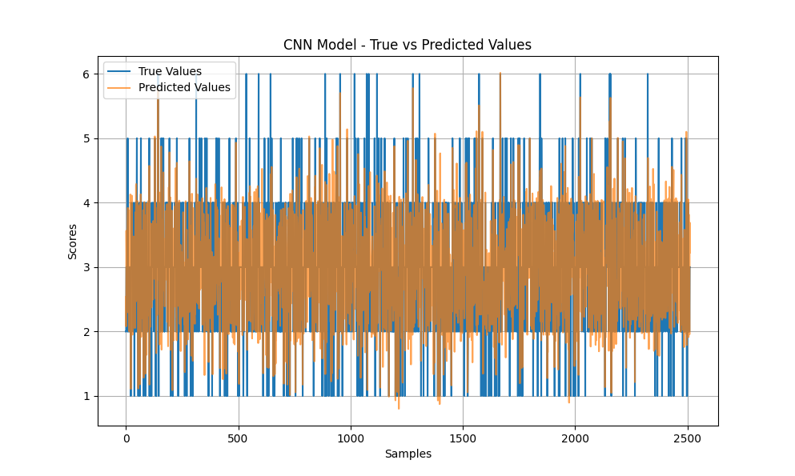
Evaluating the CNN Model

Slide 65
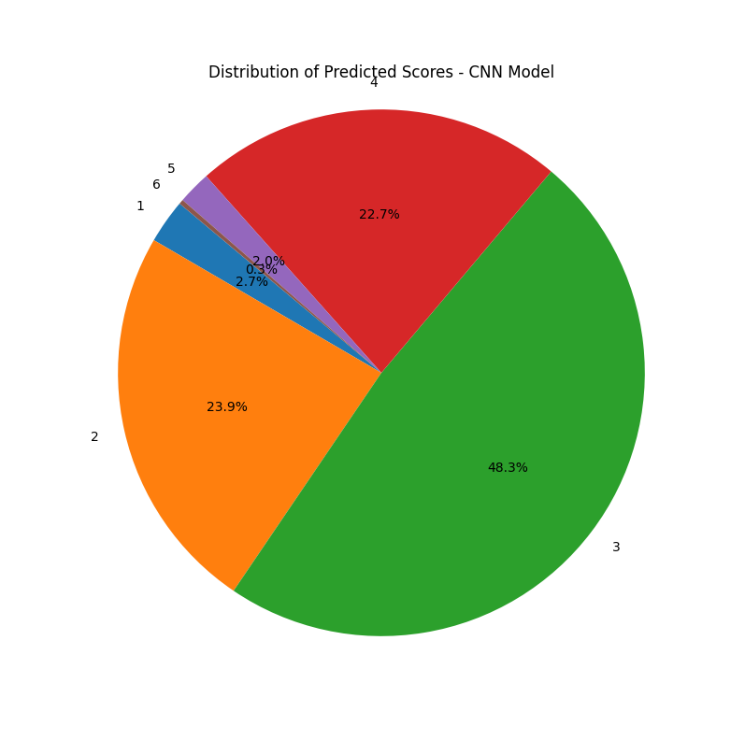
Evaluating the CNN Model

Slide 66
Best Predictions

Slide 67
Evaluating the CNN Model
Model: CNN Model, Type: Best
True Score: 3 Predicted Score: 2.9999098777770996 Error: 0.00009012222290039062 Number of Sentences: 1 Number of Words: 224 Unique Words: 122
Essay Text:
The Electoral College system means that voters don't vote directly for the president but for a slate of electors who then elect the president. Bradford Plumer explains that citizens of the United States aren't voting directly for the president; they vote through the Electoral College system. Changing to a popular vote system for the presidential election would allow the people of the United States to have a direct say. For instance, Richard Nixon, Jimmy Carter, and Bob Dole, along with the U.S. Chamber of Commerce and the AFL-CIO, have agreed on abolishing the Electoral College. If the election were based on the popular vote, it would make voting fairer, allowing the people's voices to be heard more clearly. The popular vote system would be more fair, as it eliminates favoritism...

Slide 68
Evaluating the CNN Model
Model: CNN Model, Type: Best
True Score: 2 Predicted Score: 1.9998083114624023 Error: 0.00019168853759765625 Number of Sentences: 1 Number of Words: 153 Unique Words: 96
Essay Text:
Dear State Senator, Honestly, we should keep the Electoral College. It's unfair, outdated, and irrational. Citizens in each state vote, but I don't think electors care about winning the presidential candidate they are supposed to represent. I would like to call the Electoral College a disaster. I agree with Mr. Plumer. Bradford Plumer said, "Even the best-laid defense of the Electoral College system is wrong." Faithless electors occasionally refuse to vote for their party's candidate, casting deciding votes for whomever they please. That's heartless. This is another reason I don't like the system. It doesn't care about the voters. I'm pretty sure voters would prefer a fair system...

Slide 69
Worst Predictions

Slide 70
Evaluating the CNN Model
Model: CNN Model, Type: Worst
True Score: 1 Predicted Score: 3.5802927017211914 Error: 2.5802927017211914 Number of Sentences: 1 Number of Words: 245 Unique Words: 178
Essay Text:
Driverless cars could be helpful and seem safe. They are already used by Google and could help people with disabilities that make them unable to drive go where they need to go. First, using sensors to help navigate, developing special roads, smart roads, and test tracks built by General Motors, they built concept cars that could run on special tracks embedded with electrical cables that sent radio signals to a receiver at the front end of the car. Engineers at Berkeley tried something similar using magnets with alternating polarity that the car could read using binary code. However, this proved expensive, so they started putting sensors in the car for position estimation...

Slide 71
Evaluating the CNN Model
Model: CNN Model, Type: Worst
True Score: 6 Predicted Score: 3.3951730728149414 Error: 2.6048269271850586 Number of Sentences: 1 Number of Words: 449 Unique Words: 237
Essay Text:
Within Nick Dalto's article "Making Mona Lisa Smile," Nick helps view the value of using technology to read one's emotional expression. Using technology to read emotional expressions of students within a classroom is beneficial. One facial expression throughout a painting helps distinguish how one felt. Technology is used for many things, including the Facial Action Coding System. By using new technology to read expressions given in Leonardo da Vinci's Renaissance painting, "Mona Lisa," Dalto helps put reasoning behind the new Facial Action Coding System. This system has promising applications throughout various fields...

Slide 72
Hybrid Model

Slide 73
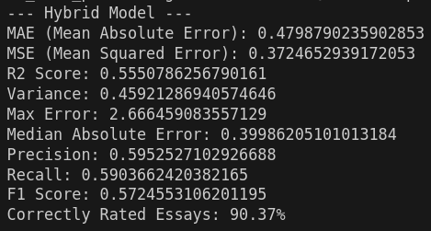
Evaluating the Hybrid Model

Slide 74
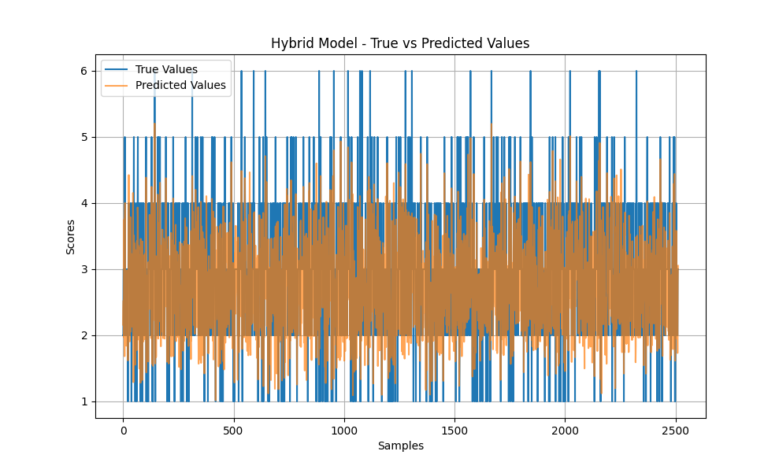
Evaluating the Hybrid Model

Slide 75
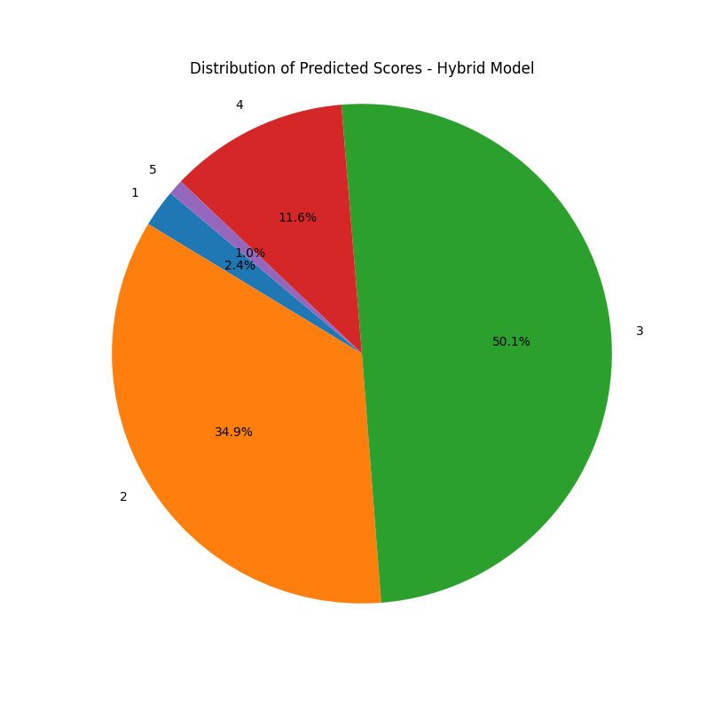
Evaluating the CNN Model

Slide 76
Best Predictions

Slide 77
Evaluating the Hybrid Model
Model: Hybrid Model, Type: Best
True Score: 2 Predicted Score: 1.999540090560913 Error: 0.00045990943908691406 Number of Sentences: 1 Number of Words: 87 Unique Words: 55
Essay Text:
Seagoing cowboys had the opportunity to travel to many places, such as China and Europe. Their job was to take care of horses, cows, and mules being shipped overseas. They also benefited from the experience of traveling by sea to places like Greece and Italy. In their free time, seagoing cowboys played baseball, volleyball, table tennis, and participated in tournaments for fencing and boxing. Reading, whittling, and games helped pass the time. One disadvantage was getting seasick and dealing with difficult animals occasionally. Despite these challenges, being a seagoing cowboy offered great travel experiences and recreational activities while helping with important work.

Slide 78
Evaluating the Hybrid Model
Model: Hybrid Model, Type: Best
True Score: 3 Predicted Score: 2.9992470741271973 Error: 0.0007529258728027344 Number of Sentences: 1 Number of Words: 153 Unique Words: 97
Essay Text:
I think driverless cars have the potential to be significantly safer than manually driven cars. Many people get distracted by their phones while driving, and bad drivers make the roads unsafe. Driverless cars would lift the responsibility of passenger safety from the driver’s shoulders, potentially saving thousands of lives. Google's driverless car has driven half a million miles without a crash, even though it sometimes requires partial manual control. This is a good sign for the safety of driverless cars. Yes, people may still need to learn how to drive, but with fewer cars on the road and fewer people driving, there would be less chance of accidents. Part of the sensor system...

Slide 79
Worst Predictions

Slide 80
Evaluating the Hybrid Model
Model: Hybrid Model, Type: Worst
True Score: 6 Predicted Score: 3.7446117401123047 Error: 2.2553882598876953 Number of Sentences: 1 Number of Words: 306 Unique Words: 216
Essay Text:
The author of the article focused on one thing: describing the reasons traveling to Venus is unsafe, yet completely ignoring the reasoning behind replacing unrealistic claims with more factual ones. The article states that astronomers want to explore Venus and mentions its density, often referring to it as Earth's twin, but it bypasses the subject of how the cost affects the United States as a whole. The author fails to realize how unsafe it actually is to go to Venus. Even if we talk about electronics made from silicon carbide, it doesn't change the fact that no one could survive the 800-degree weather there, and neither could a spaceship. The space carrier would melt upon entering Venus's orbit...

Slide 81
Evaluating the Hybrid Model
Model: Hybrid Model, Type: Worst
True Score: 6 Predicted Score: 3.333540916442871 Error: 2.666459083557129 Number of Sentences: 1 Number of Words: 449 Unique Words: 237
Essay Text:
Within Nick Dalton's article "Making Mona Lisa Smile," Nick helps readers view the value of using technology to read one's emotional expression. Using technology to read emotional expressions of students within a classroom can be beneficial. A single facial expression throughout a painting helps distinguish how one felt. Technology is used for many things, including the Facial Action Coding System. By using new technology to read expressions in Leonardo da Vinci's Renaissance painting, "Mona Lisa," Dalto helps put reasoning behind the new Facial Action Coding System. This system has promising applications across various fields...

Slide 82
Comparison between models

Slide 83
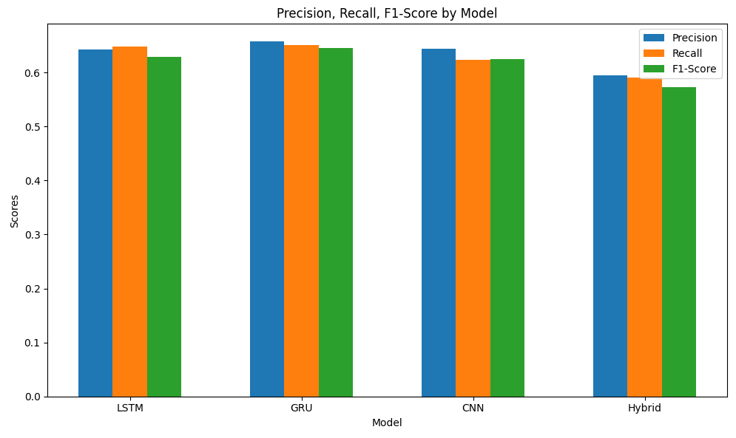
Comparison between the models

Slide 84
Comparison between the models
Precision: Measures how many predicted grades are correct. Higher precision means fewer false positives.
Recall: Measures how many actual grades are correctly identified. Higher recall means fewer false negatives.
F1 Score: The harmonic mean of precision and recall, balancing both metrics. Higher F1 score indicates better overall performance.
Best-Performing Model
CNN Model: Best in precision (0.64365), recall (0.6238), and F1 score (0.6242). Most reliable and effective overall.
GRU Model: Moderate precision (0.6570), recall (0.6508), and F1 score (0.6450). Decent but not as good as CNN.
LSTM Model: Lowest precision (0.6428), recall (0.6484), and F1 score (0.6283). Least reliable and effective.
Hybrid Model: Lowest precision (0.5952), recall (0.5903), and F1 score (0.5724). Least reliable and effective.

Slide 85
Comparison between the models
CNN Model performs the best, correctly rating 82.22% of essays.
GRU Model is the second best with 92.08%.
LSTM Model has the lowest percentage, correctly rating 92.08% of essays.
Hybrid Model has the lowest percentage, correctly rating 90.37% of essays.
Best-Performing Model
The GRU model has the highest percentage of correctly rated essays, indicating it is the most accurate in terms of classification among the three models.
Best Model
The CNN model has the best result in all the metrics, with the GRU model been really near and has the best performance. But I’ll say that the CNN model is the best model because it has almost the same performance than the GRU model, but the best texts of CNN model have more phrases, more words and more unique words, making it capable of more complex texts with a very good performance.

Slide 86
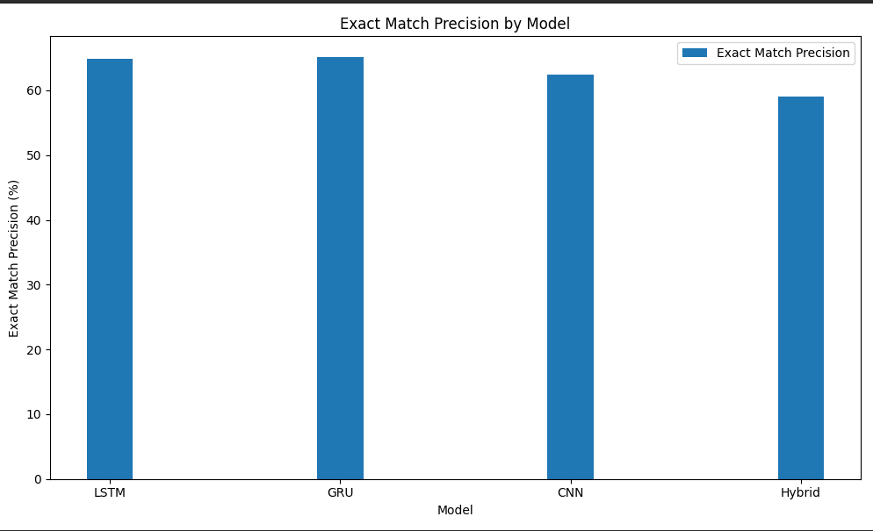
Comparison between the models

